Slide 1
Earth Protectors Conference For Primary Educators
28th February 2020

Slide 2
International Baccalaureate 3-18yrs
Primary Years Programme PYP 3-12
Middle Years Programme MYP 12-16
Diploma Programme DP 17-18

Slide 3
Primary Years Programme
The IB Primary Years Programme, for students aged 3 to 12, focuses on the development of the whole child as an inquirer, both in the classroom and in the world outside, using a framework of six transdisciplinary themes of global significance.

Slide 4
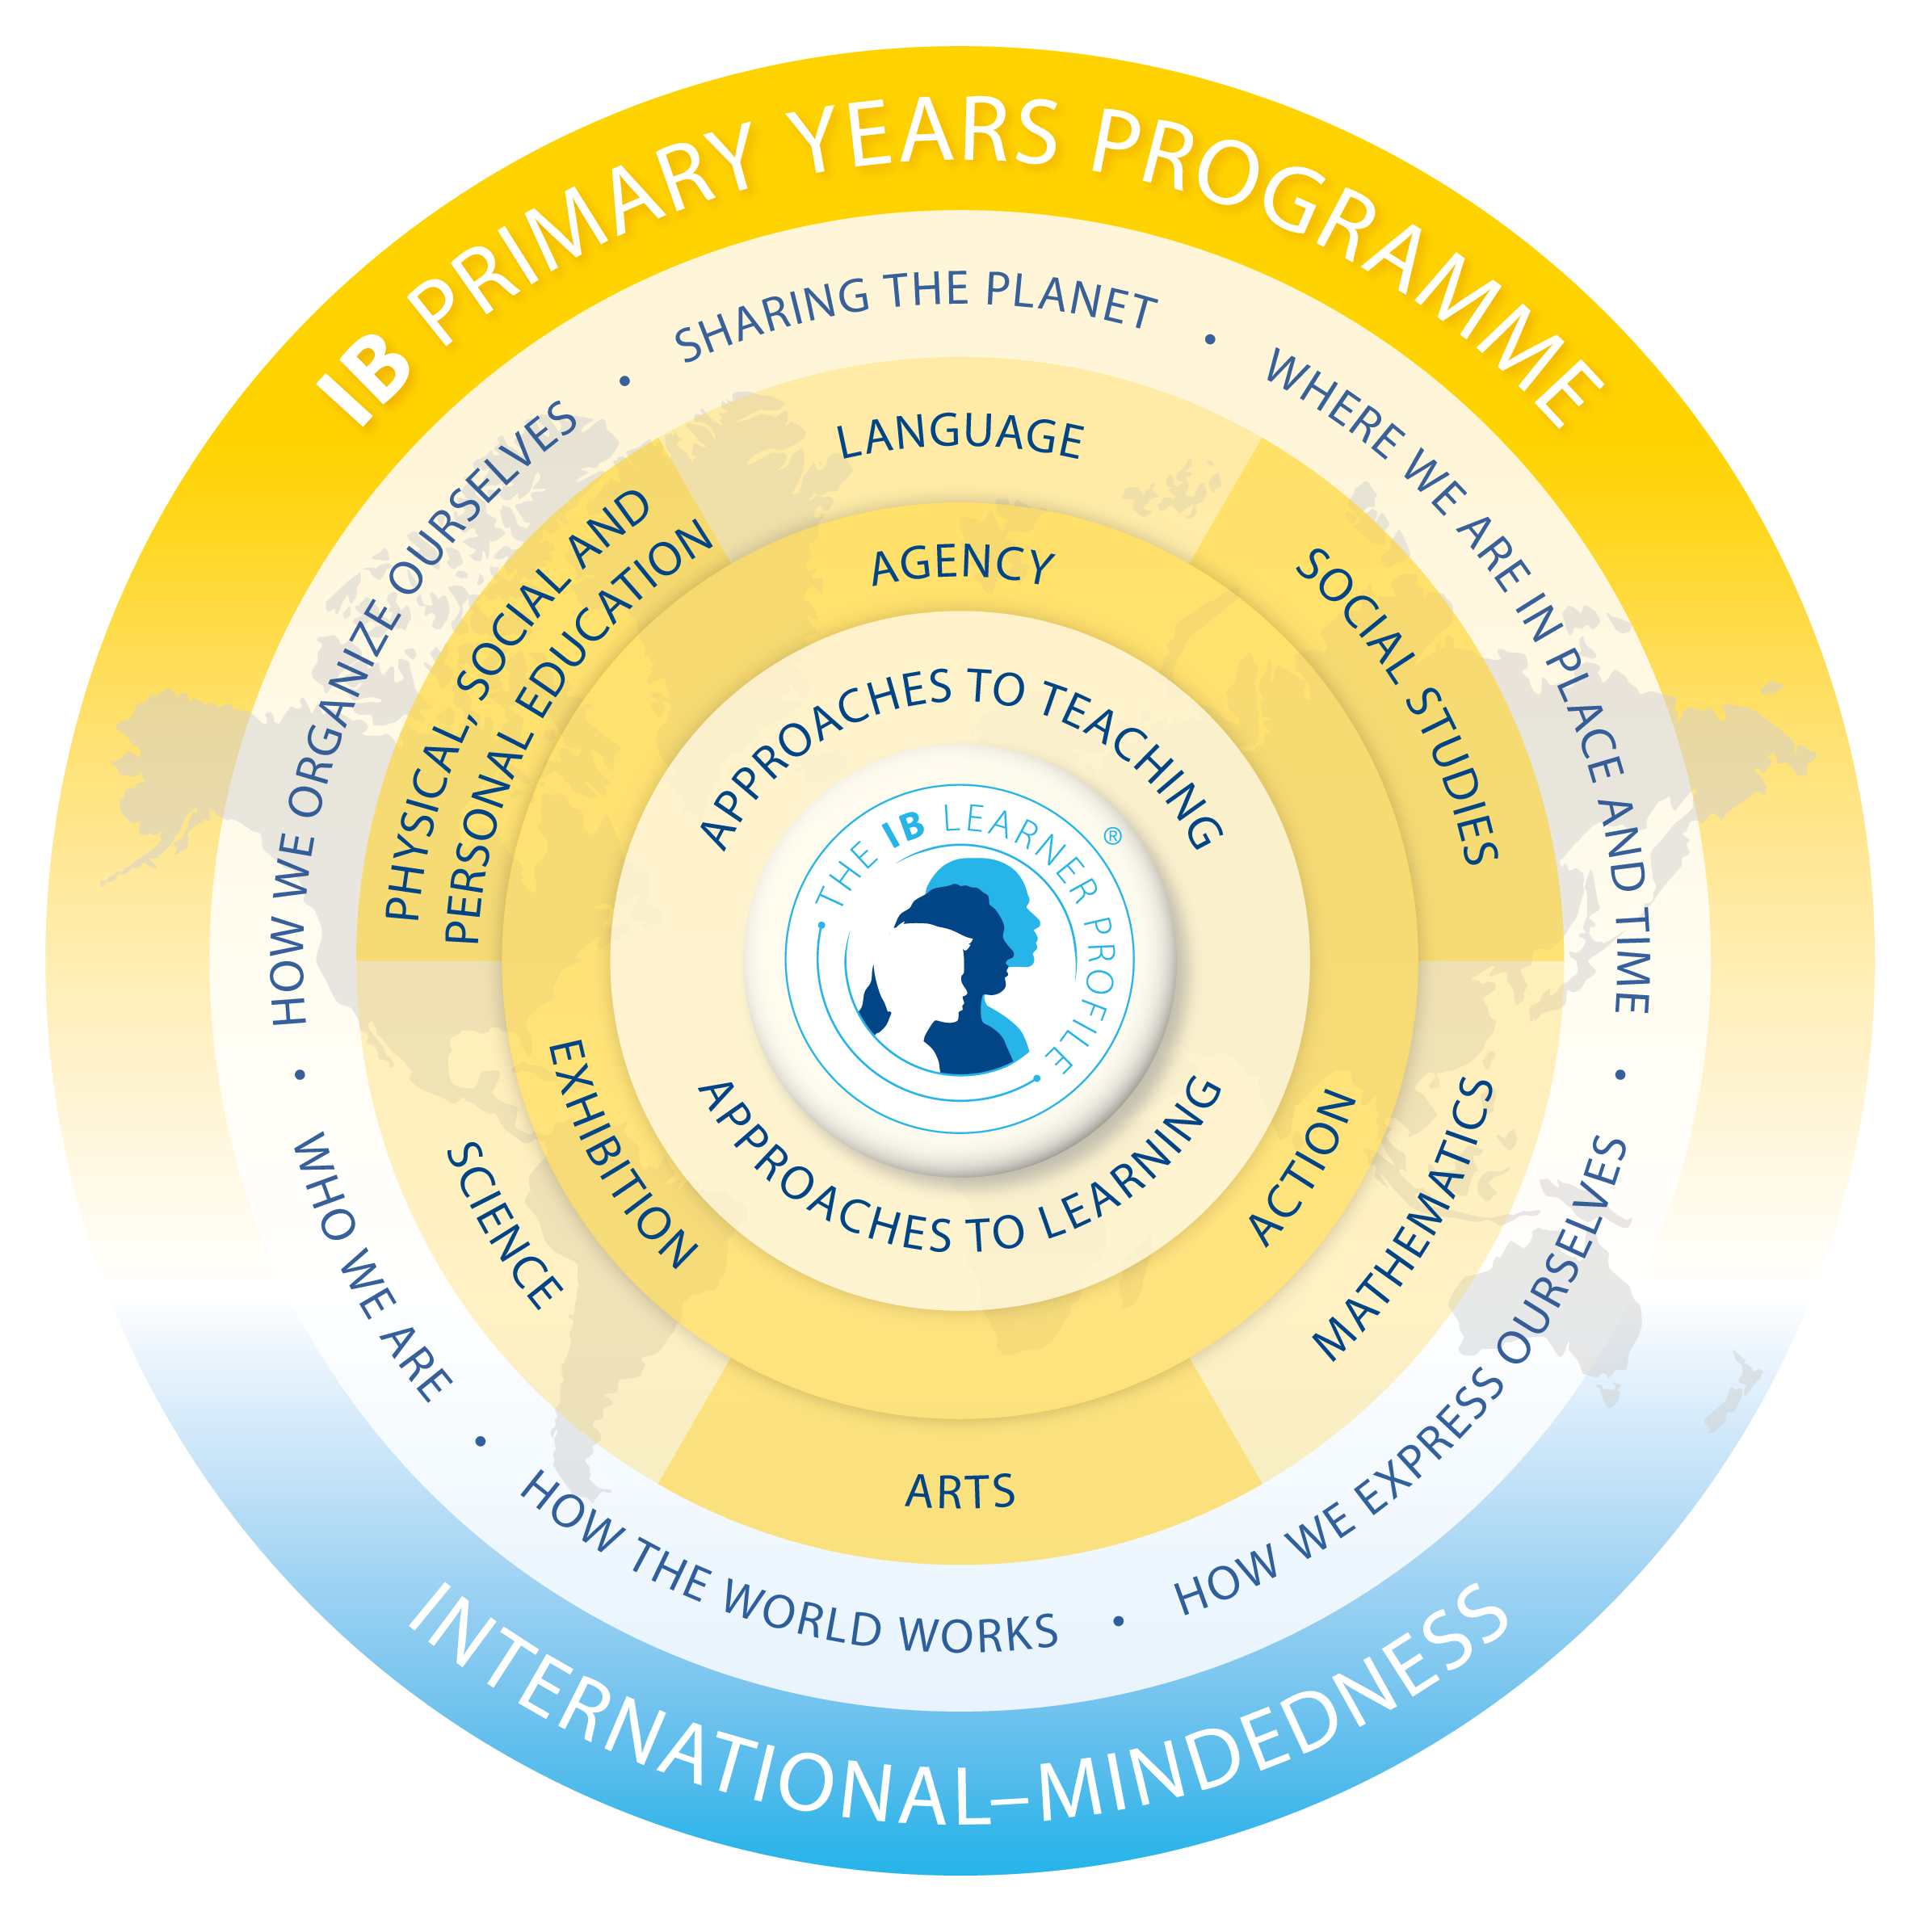
International Baccalaureate
Primary Years Programme
Curriculum is delivered under six transdisciplinary themes:
Who We Are
Sharing the Planet
Where We Are in Place and Time
How We Organise Ourselves
How the World Works
How We Express Ourselves
Notes:
Similar curriculum to Key stages but different approach
1-6 Cultures; Ecology; History; Social Studies; Science; Arts

Slide 5
International Baccalaureate
Primary Years Programme
What are the elements of the programme?
Knowledge
Skills (Approaches to learning)
Concepts
Culminating in action
Notes:
Similar curriculum to Key stages but different approach
1-6 Cultures; Ecology; History; Social Studies; Science; Arts

Slide 6
Sample unit of inquiry for transdisciplinary theme:
Sharing the planet
(for students aged 8-9)
Central idea: Water is essential to life and is a limited resource for many people.
PYP concepts: Function
Responsibility
Lines of inquiry:
Sources of water and how water is used
Distribution and availability of usable water
Responsibilities regarding water
To support this inquiry students would
develop:
knowledge
concepts of sustainability
skills derived from science and
social studies
and then take action
Notes:
Similar curriculum to Key stages but different approach
1-6 Cultures; Ecology; History; Social Studies; Science; Arts

Slide 7
ACTION AND AGENCY
PYP students with agency use their own will and initiative, in order to take responsibility and ownership of their learning.
They direct their learning with a strong sense of identity and self-belief and, in conjunction with others, they build a sense of community and awareness of the opinions, values and needs of others. This leads to action.

Slide 8
Year 1 Sharing the Planet
Central idea: People’s choices in their use of materials can reduce waste
Concepts: Form Change Connection
Lines of inquiry:
How people use the Earth’s resources
The impact of people’s use of resources on the environment
Personal choices that can sustain the Earth’s resources responsibly
Action: Fashion parade with costumes made from recycled materials; 3 Rs; posters
Notes:
When we did in Year 1 and what they did last year: Year 1 (our Kindergarten)

Slide 9
Year 2 Sharing the Planet
Central idea: The healthy growth of plants and animals is dependent on their shared habitat
Concepts: Form Function Connection
Lines of Inquiry:
Classification of plants and animals
Conditions for healthy growth (of plants and animals)
Ways animals and plants interact in a shared habitat
Action: bird boxes; plants
Notes:
Luna Luca Tyne

Slide 10
Year 3 Sharing the Planet
Central idea: Human influence can have a positive and negative impact on the Earth’s ecosystems
Concepts: Connection Change Responsibility
Lines of Inquiry:
Interdependence of plants and animals in particular habitats
How living things develop in conjunction with seasonal change
Human impact on ecosystems
Action: Luna Tyne Luca share memories and information
Notes:
Luna Tyne Luca

Slide 11
Year 5 Sharing the Planet
Central idea: People have a shared responsibility to reduce their negative impact on the Earth
Concepts: Causation Change Responsibility
Lines of Inquiry:
How humans pollute
The effect of pollution on the planet
Action and decisions related to pollution
Action: students to share memories
Notes:
Sam Nina Luna Tyne Luca

Slide 12
Year 4 Sharing the Planet
Central idea: Finding peaceful solutions to conflict can lead to a better quality of human life.
Concepts: Causation Perspective Responsibility
Lines of Inquiry:
Causes of conflict
Conflict resolution and management
Living and working together peacefully
Action: Nina Luna Luca Tyne to add memories and info
Notes:
Nina Luna Tyne Luca: CONFLICT GRADE 3

Slide 13
Year 6 Sharing the Planet
Central idea: The sustainability of the environment is dependent on the ways people use energy.
Concepts: Function Causation Responsibility
Lines of Inquiry:
The origin, storage and transfer of energy
Sustainable ways to source and use energy
The impact of our demands on the environment
Action: Posters, energy debate, TED talks, reducing plastic, reducing packaging, reducing paper use in the school, drama, sharing information at assembly
Notes:
Nina Luna Tyne Luca

Slide 14
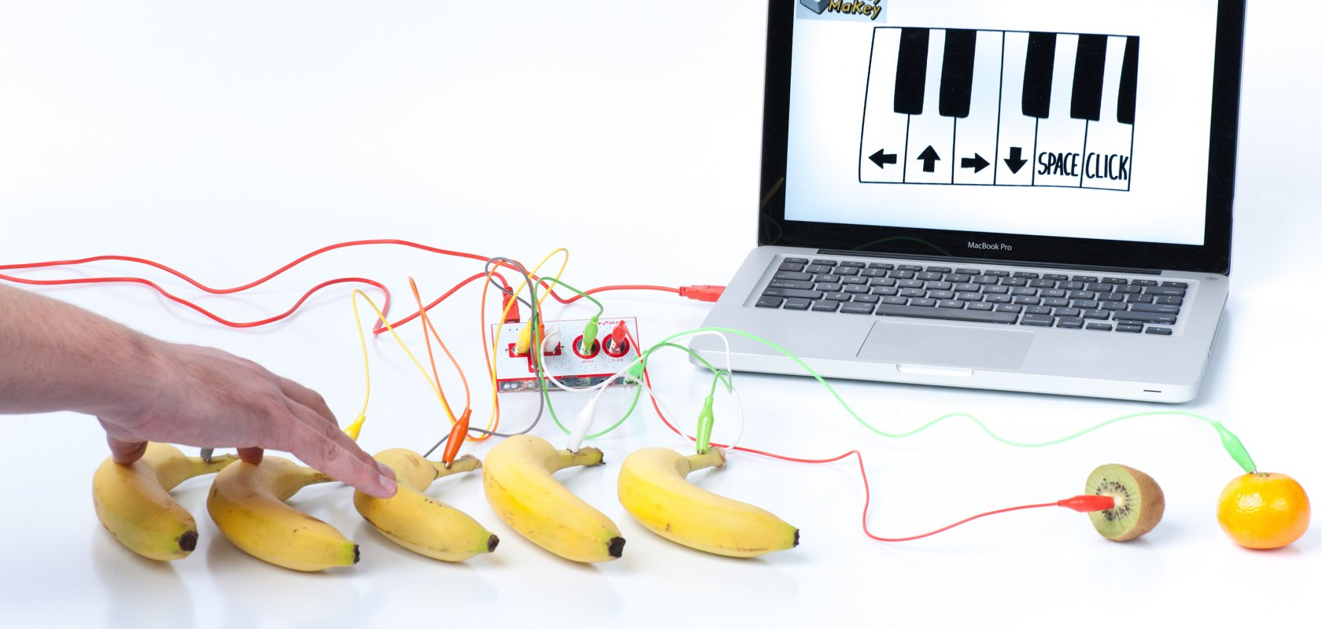
Makey Makey circuits to study electricity

Slide 15
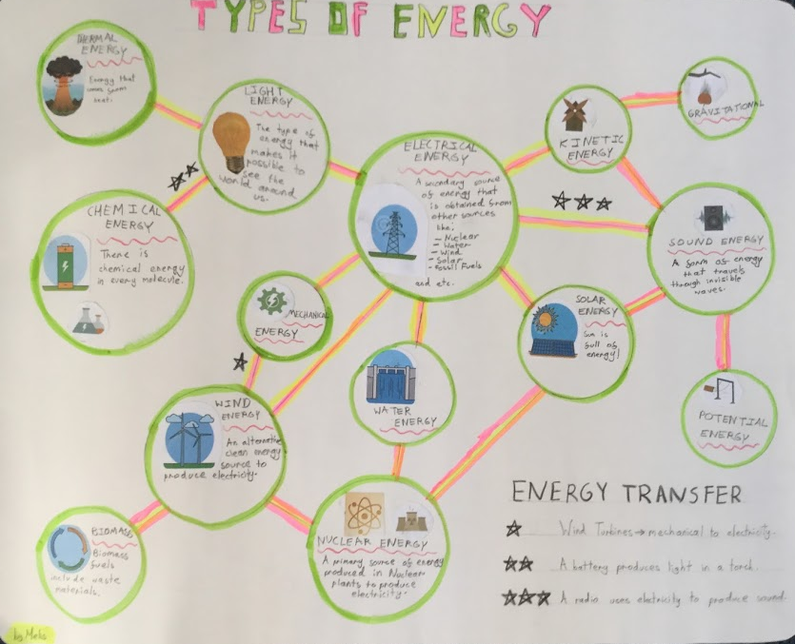
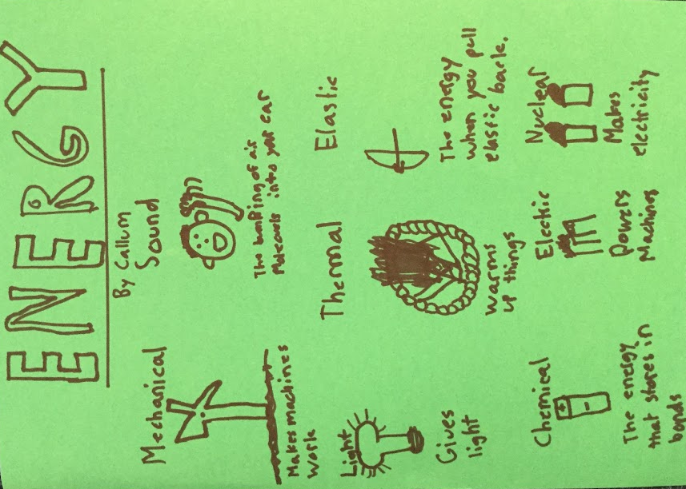

Slide 16
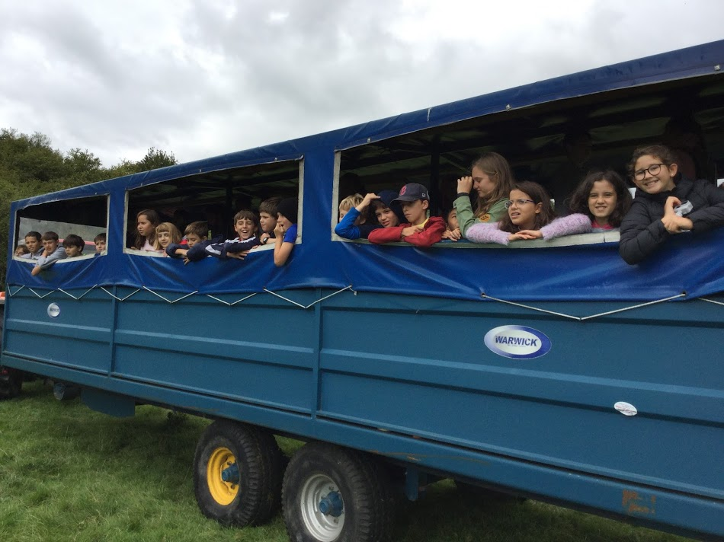
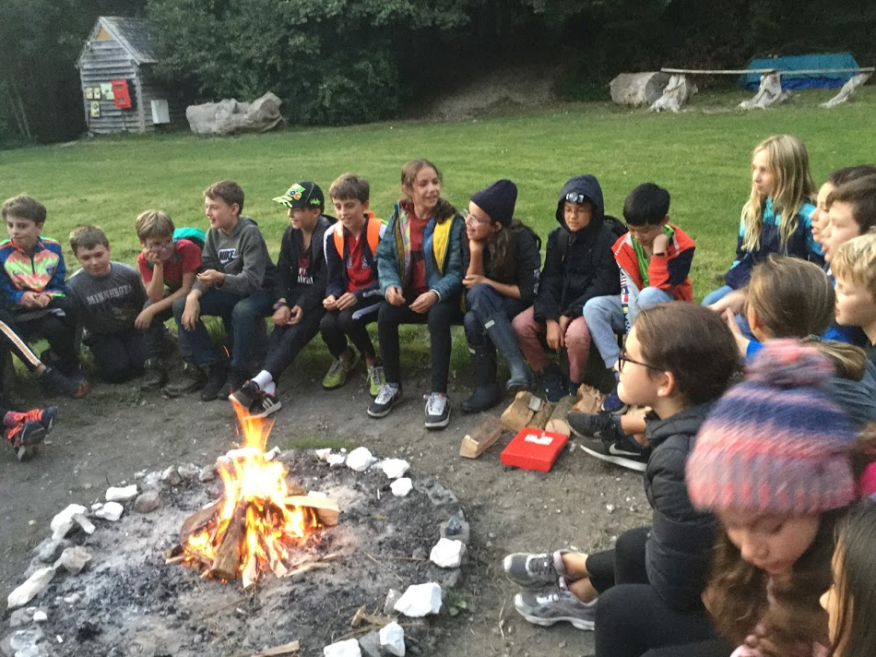
Next steps - the Sustainability Centre

Slide 17
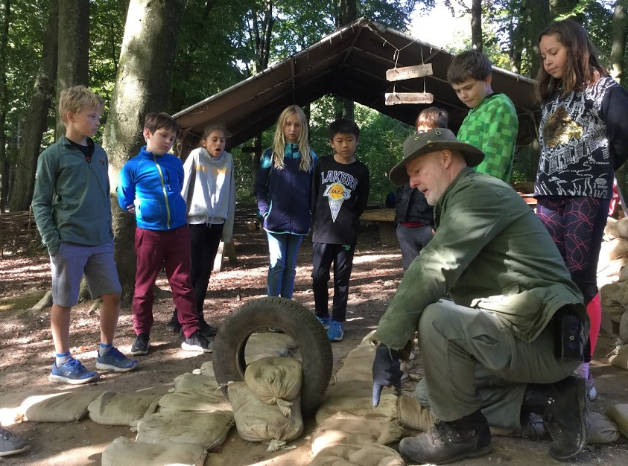
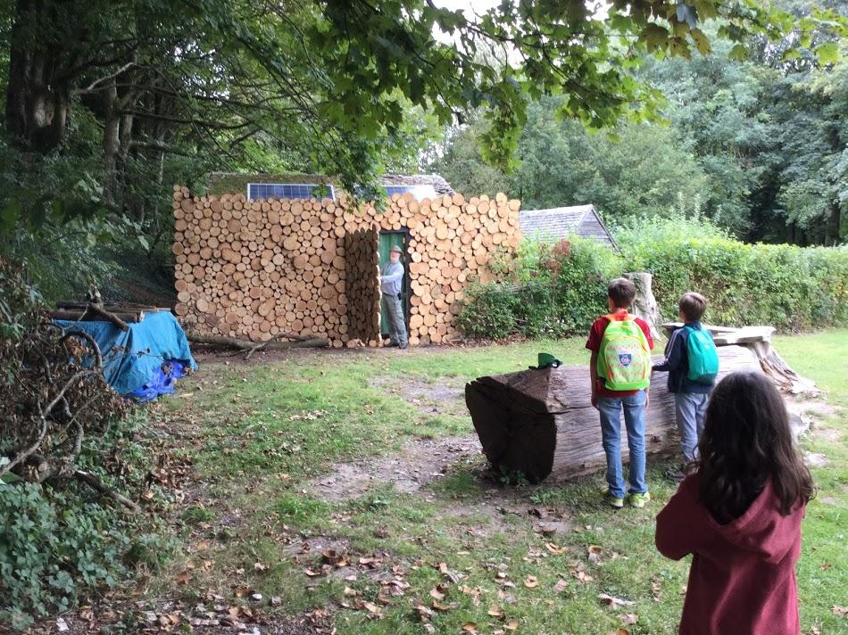
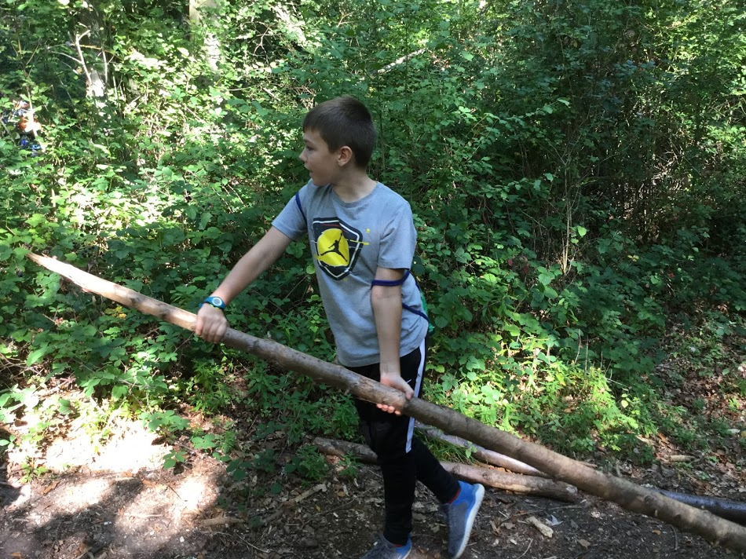
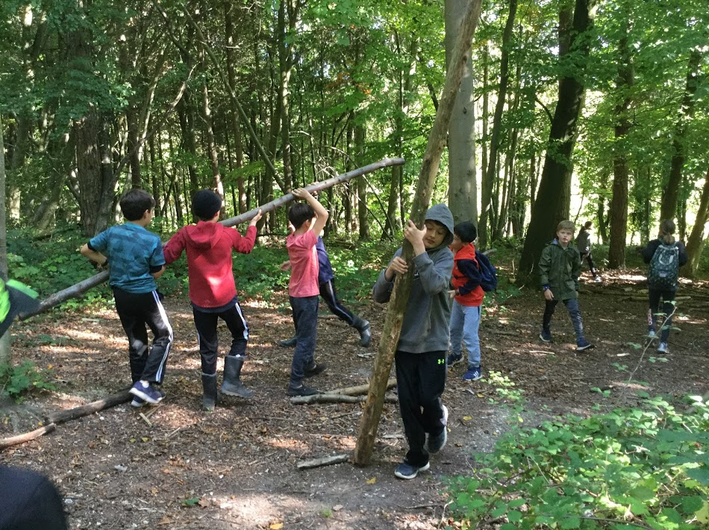
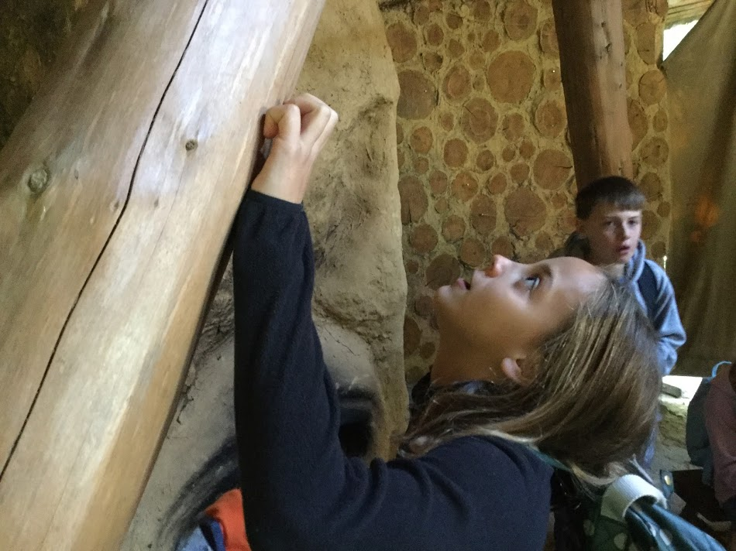
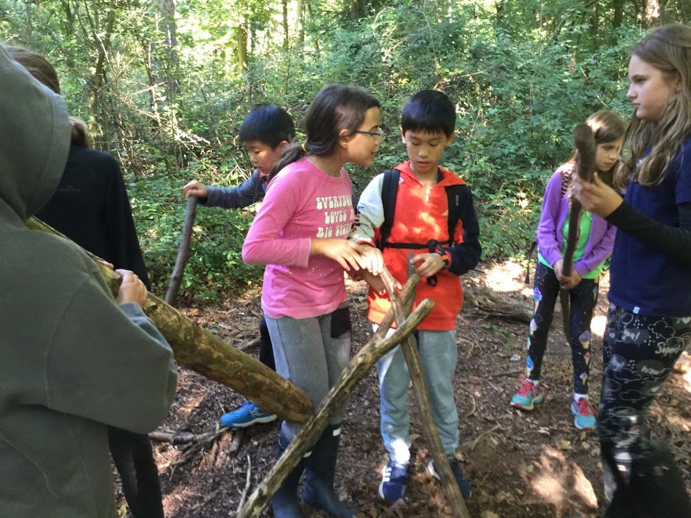
Sustainable building materials...
And making our own buildings

Slide 18
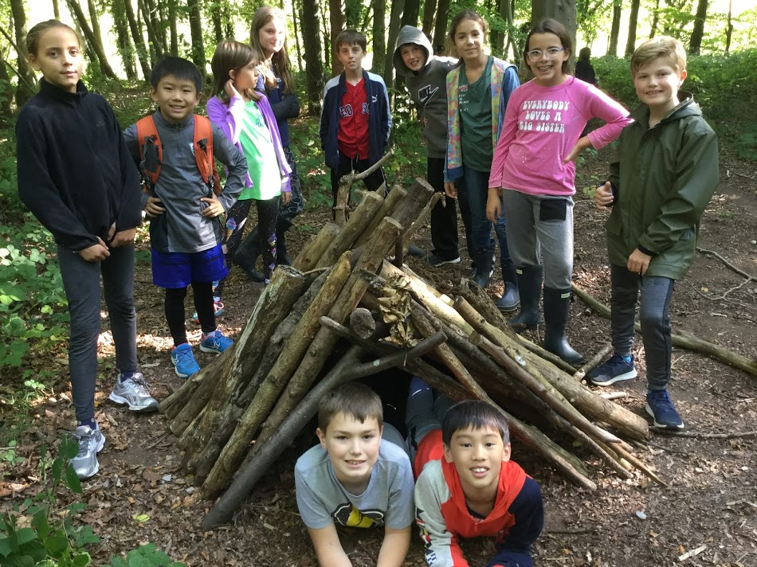
Success!

Slide 19
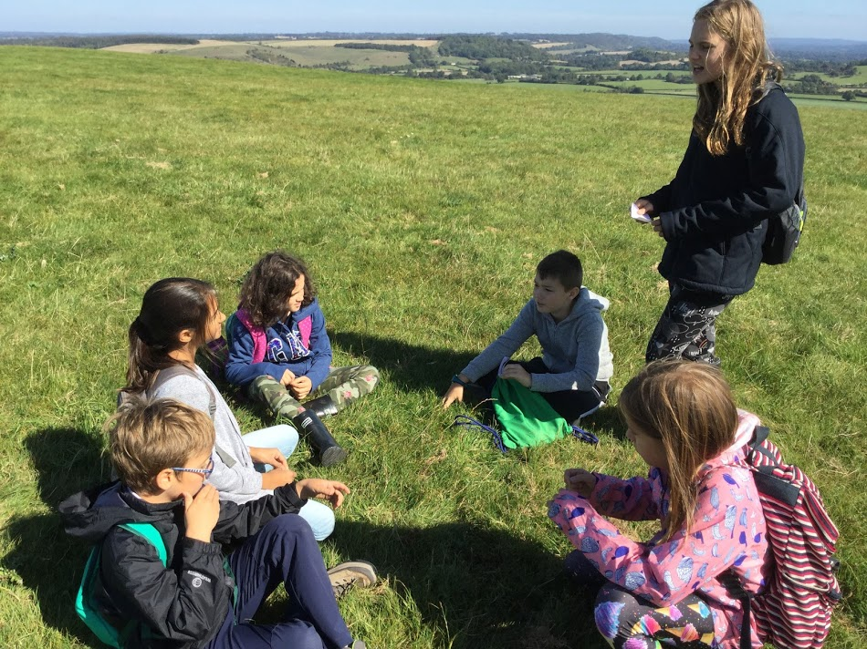
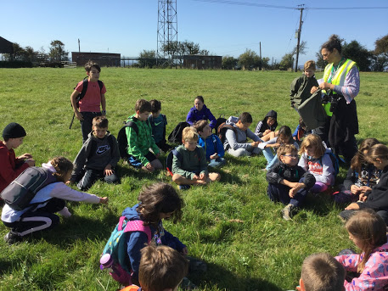
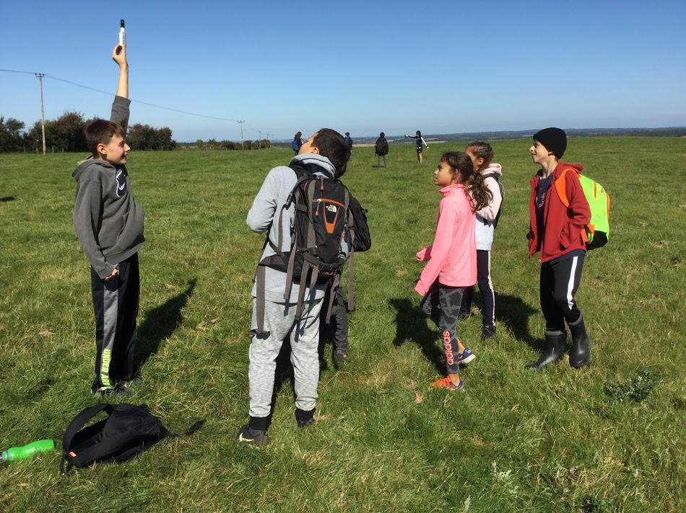
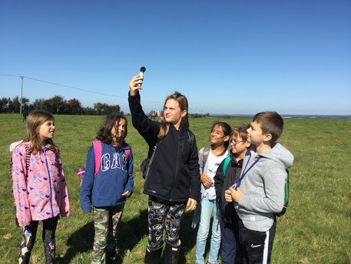
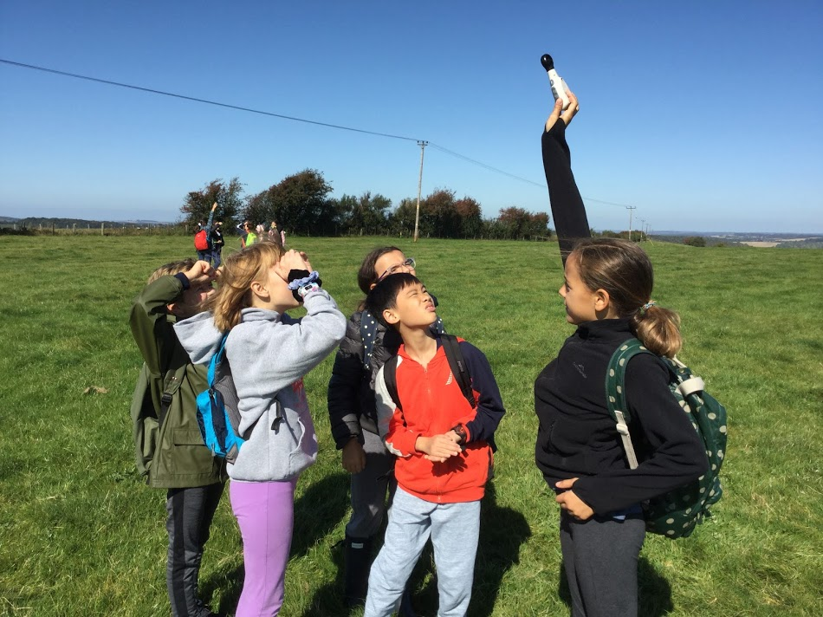
Exploring different perspectives for a proposed wind turbine site
Notes:
The farmer, the neighbours, the residents in the village, sheep, bird migration, National Parks,

Slide 20
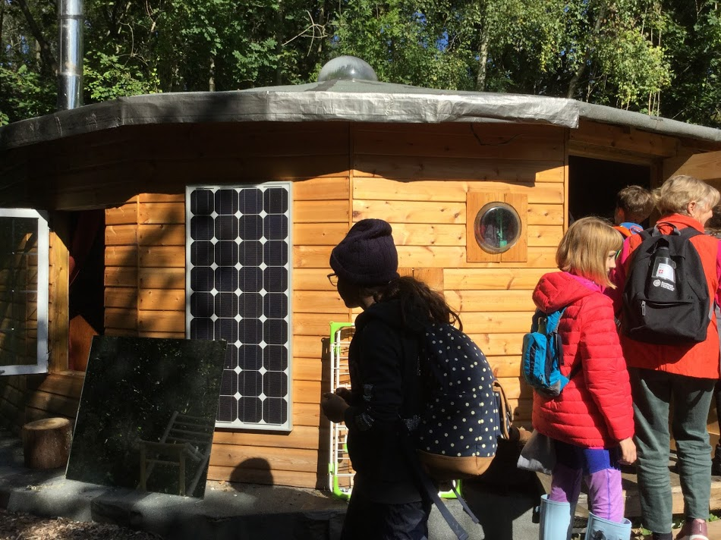
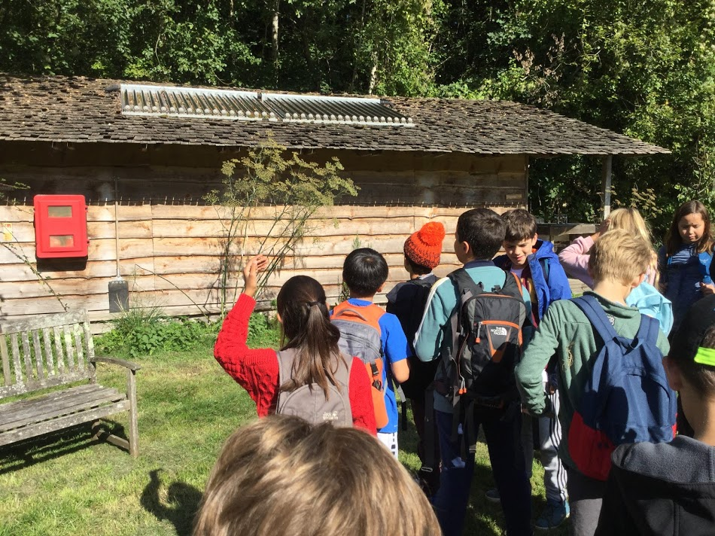
Water tubes for heating water and nearby a composting toilet.
Insulation, solar panels, porthole windows from recycled washing machine doors.

Slide 21
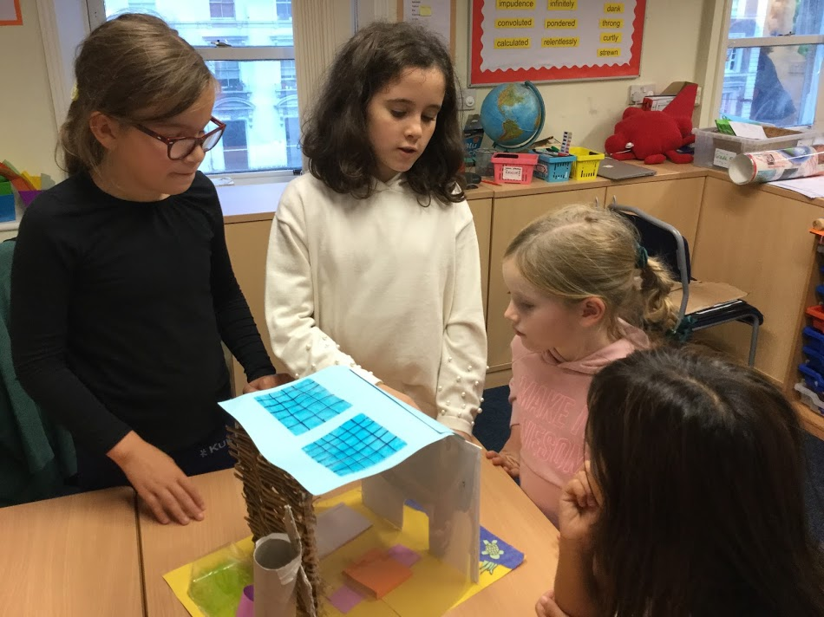
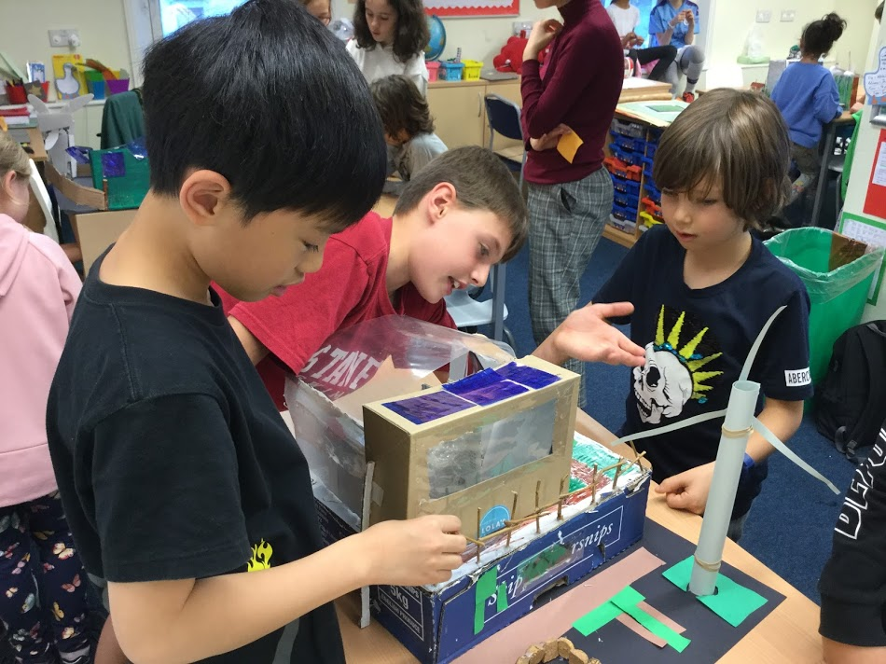
Inspired by what we had learnt, back at school we used recycled materials to make made models of sustainable buildings.
And explained all the features to our reading buddies.

Slide 22
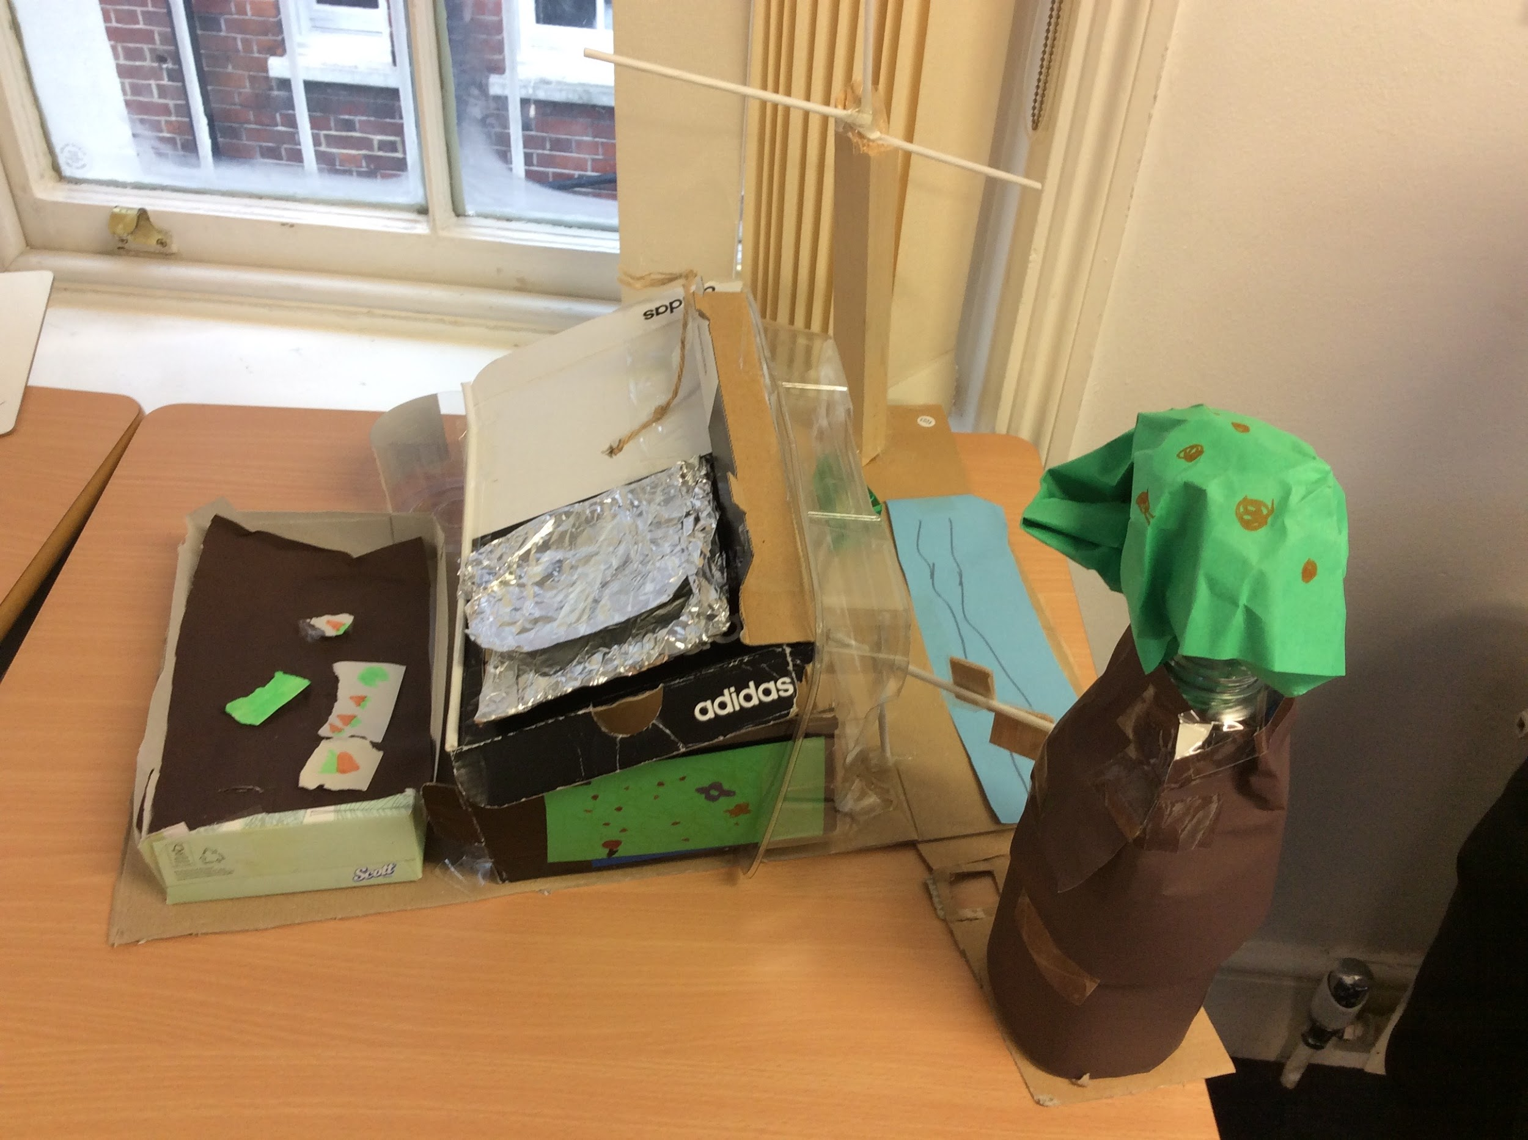
Sam: features of his model
location
materials
roof
walls
sources of energy
energy saving features

Slide 23
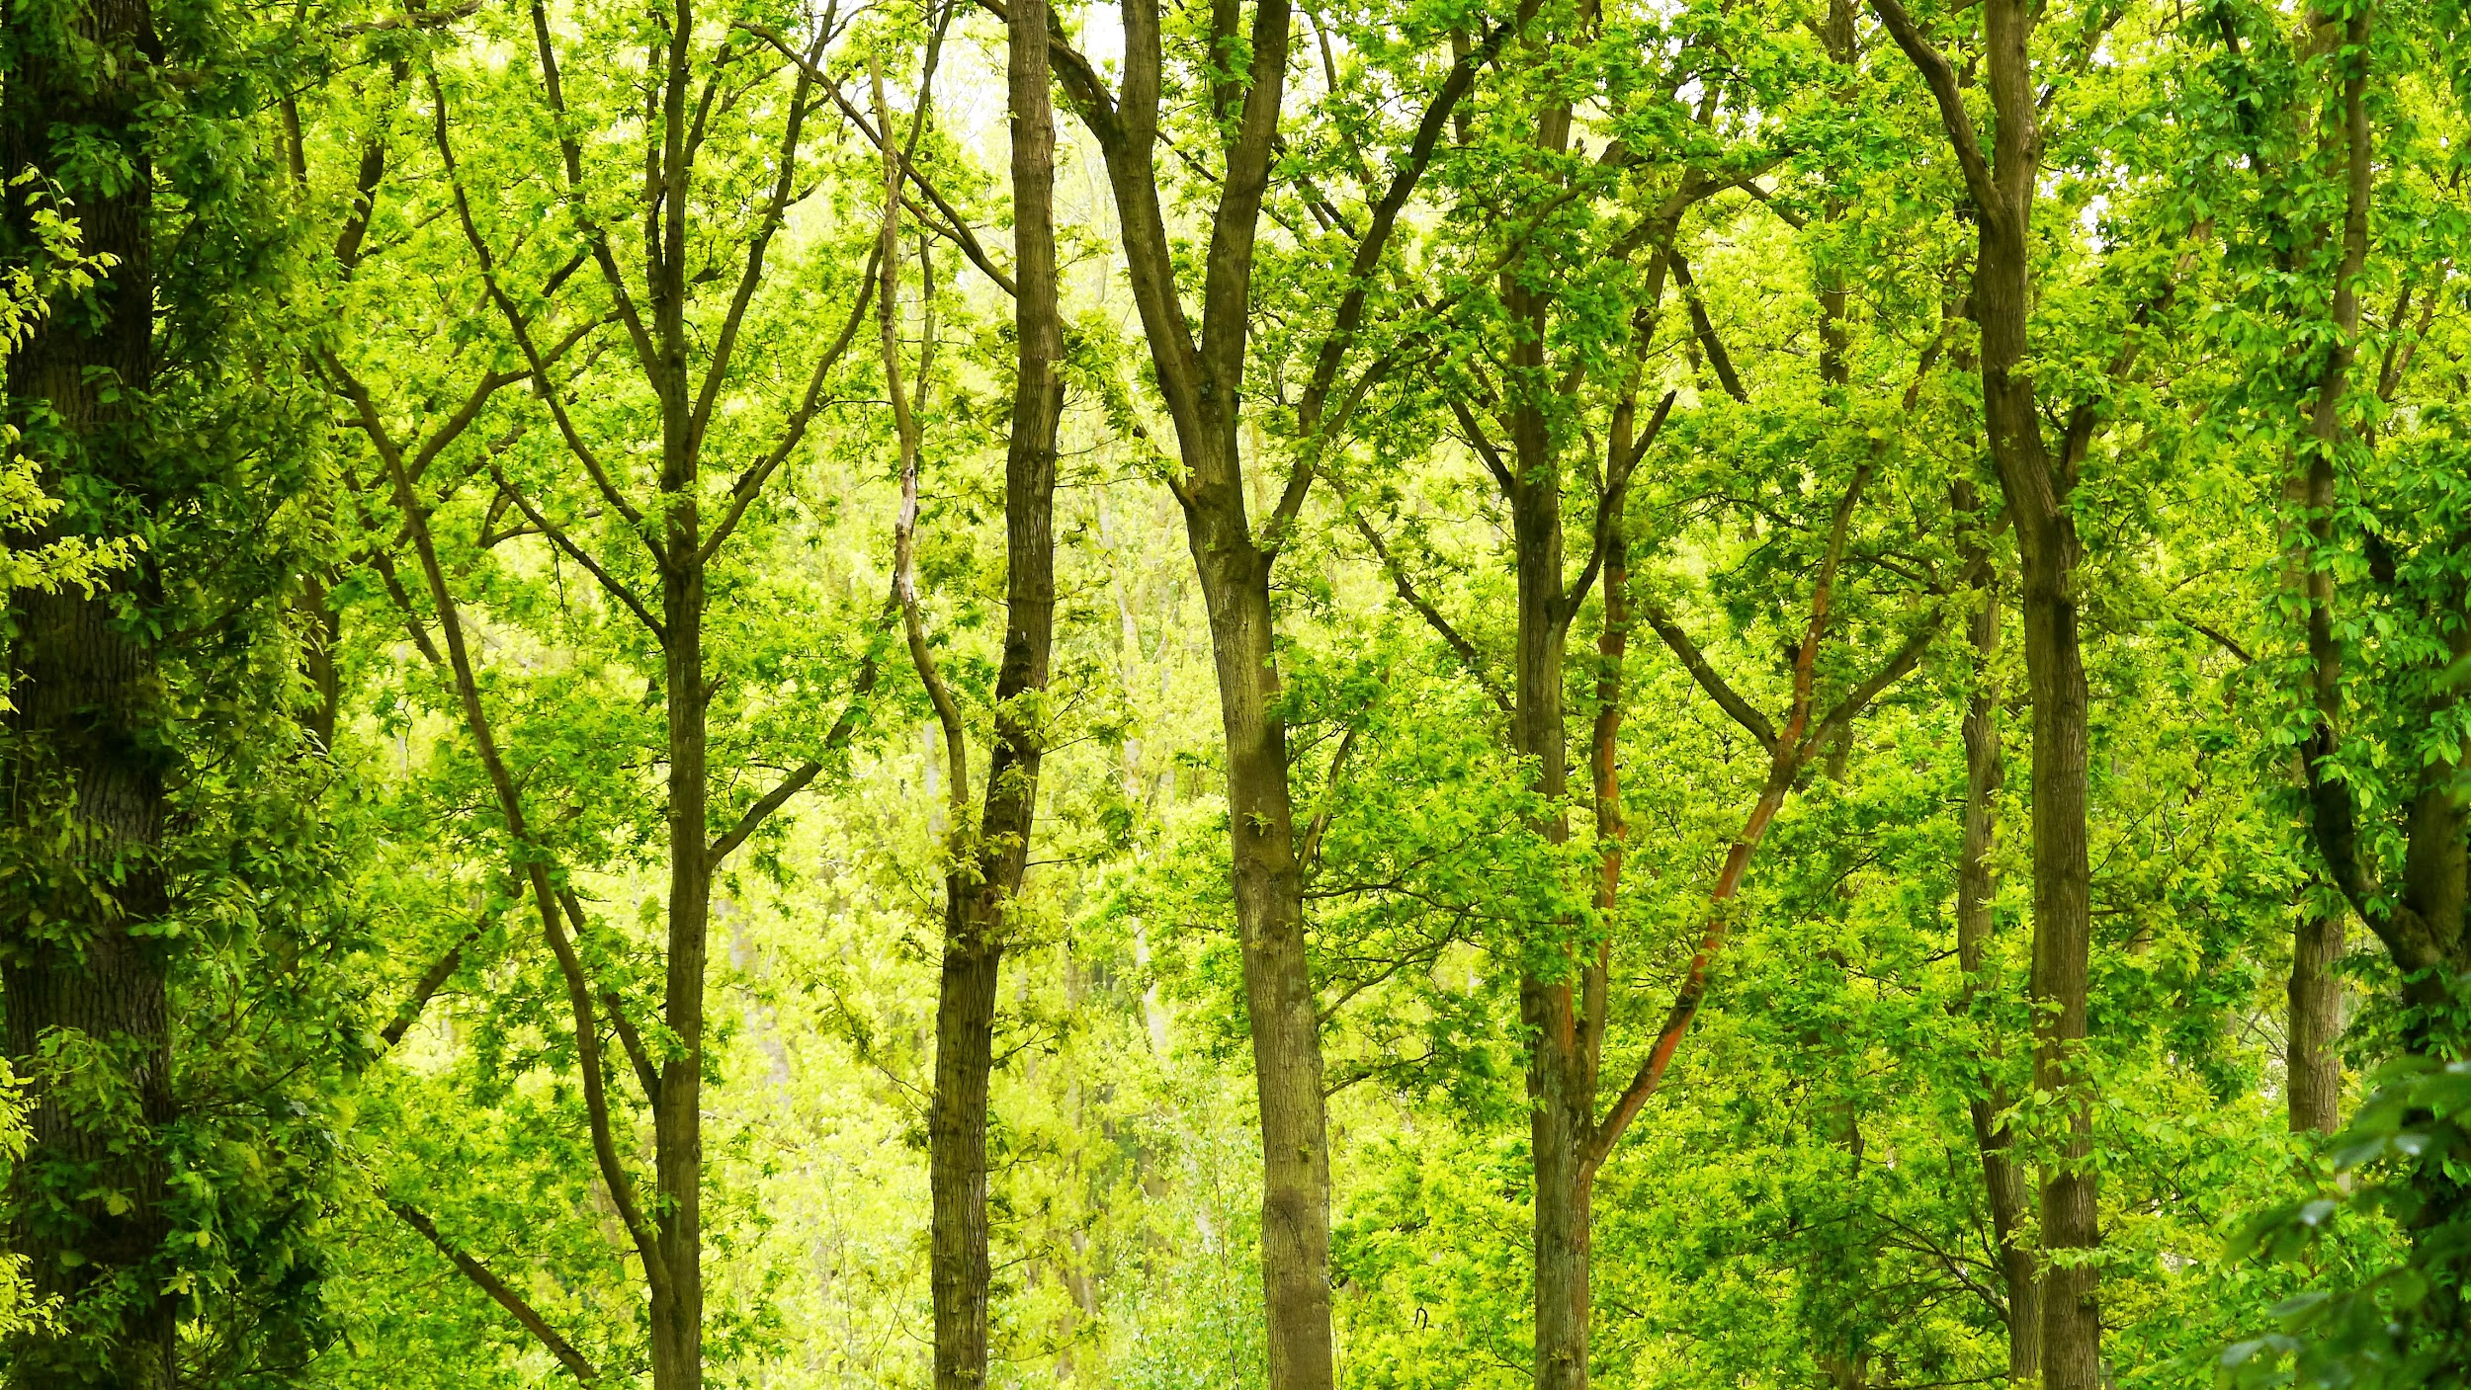
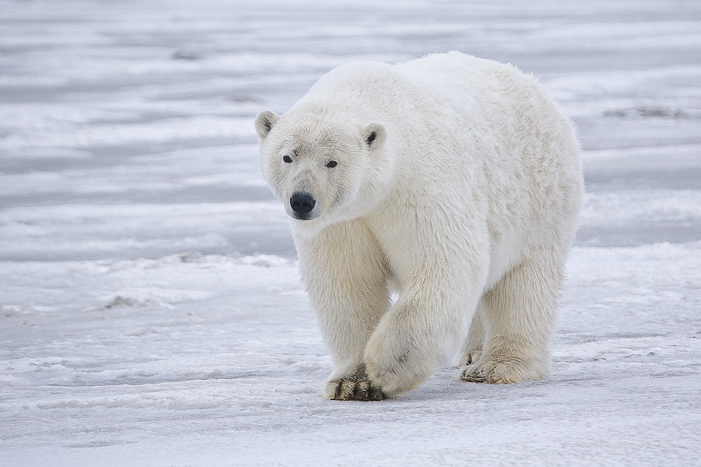
Drama in which students of the future do not know about forests or polar bears.

Slide 24
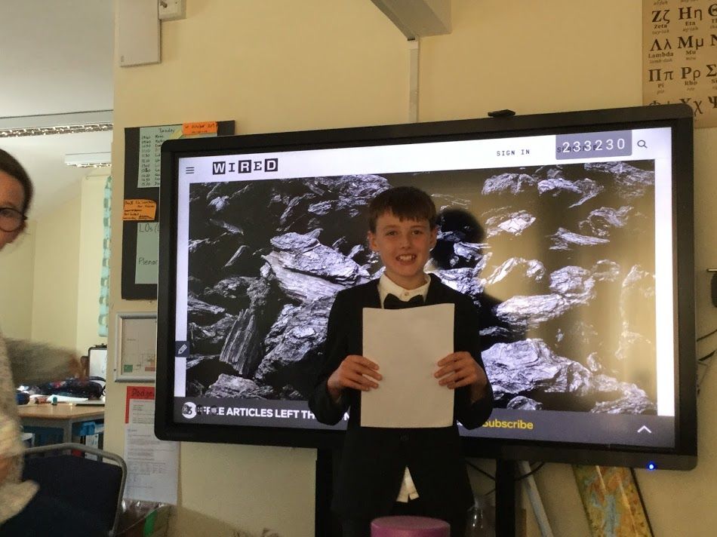
Energy Debate:
(covering advantages and disadvantages - pros and cons - of different sources)
biomass
wind
solar
tidal
hydro
geothermal
fossil fuels
nuclear
hydrogen fuel cells

Slide 25
